Slide 1
Supernova
Group J-05 St. Andrew’s Junior College
Adi Nata James Raphael Tiovalen Theodore Leebrant

Slide 2
Theme
Urban Heat Island

Slide 3
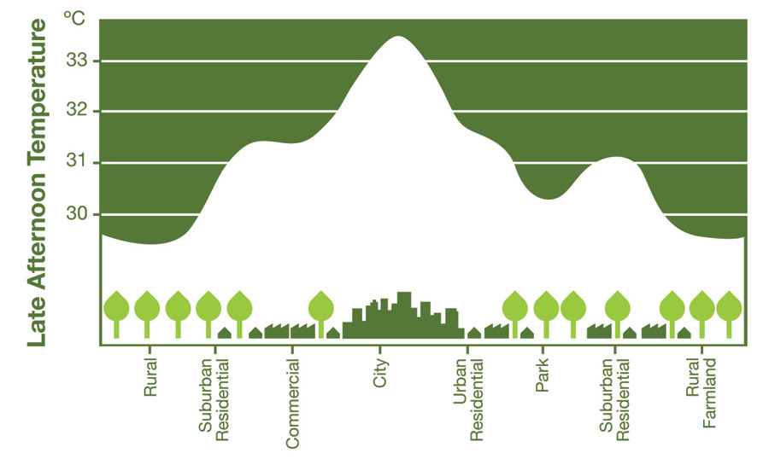
Urban Heat Island
Notes:
National Geographic Society defines Urban Heat Island as a metropolitan area that's a lot warmer than the rural areas surrounding it.

Slide 4

What causes Urban Heat Island?
Notes:
We have identified several sources of UHI:
The larger amount of thermal energy emitted in the cities (e.g. due to people, transportation, and factories, among others)

Slide 5

What causes Urban Heat Island?
Notes:
The reflection of heat from building, pavement materials, as well as the enhanced greenhouse effect

Slide 6
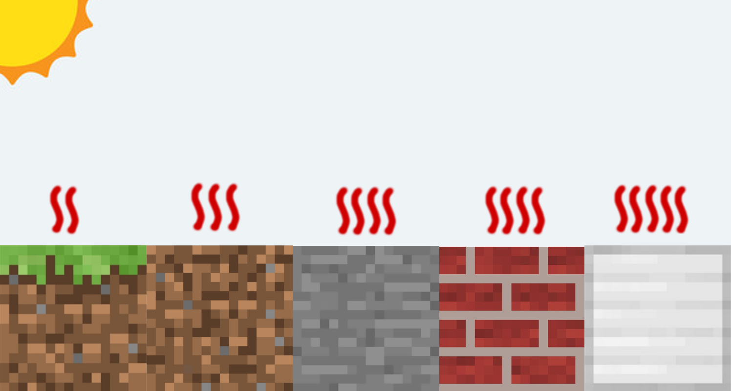
What causes Urban Heat Island?
Notes:
As well as the high thermal absorption of many materials making up the majority of the urban area.

Slide 7
Our approach

Slide 8

A fresh perspective
Notes:
This is the Energy Innovation Challenge, so we try to approach the problem from a fresh perspective.

Slide 9

Reducing heat emission?
Notes:
To reduce the emission of thermal energy, clean energy is one popular alternative. Looking at solar panels especially; they are affordable, easy to install, and lightweight. and making them widely used nowadays. However, the temperature of the posterior side of the solar cell can get very high during the operation, contributing to the UHI effect.

Slide 10
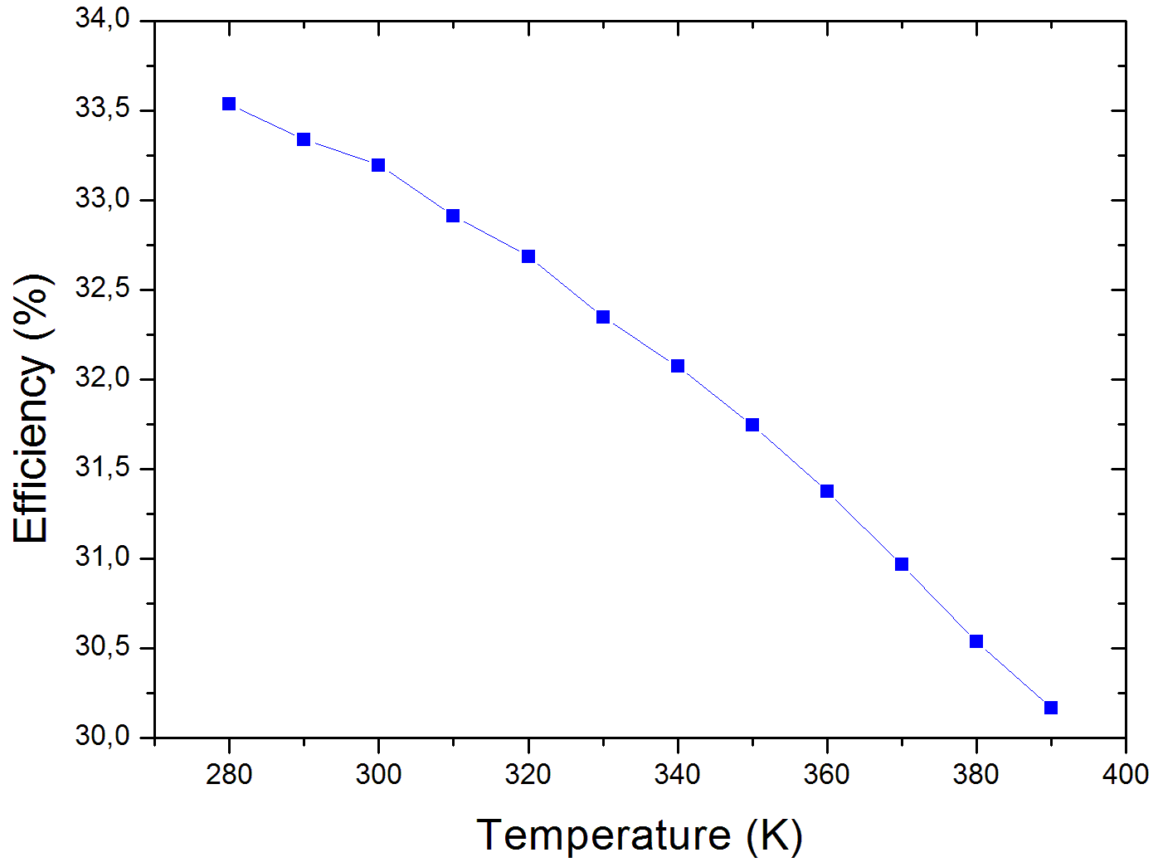
Efficiency – Temperature graph of Solar PV
Notes:
Furthermore, there is an inverse relationship between the temperature of the photovoltaic cells and their efficiency. To kill two birds with one stone…

Slide 11
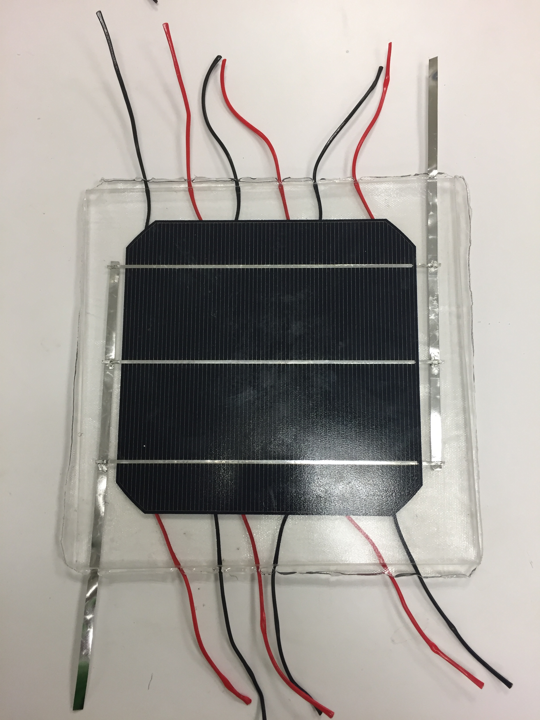
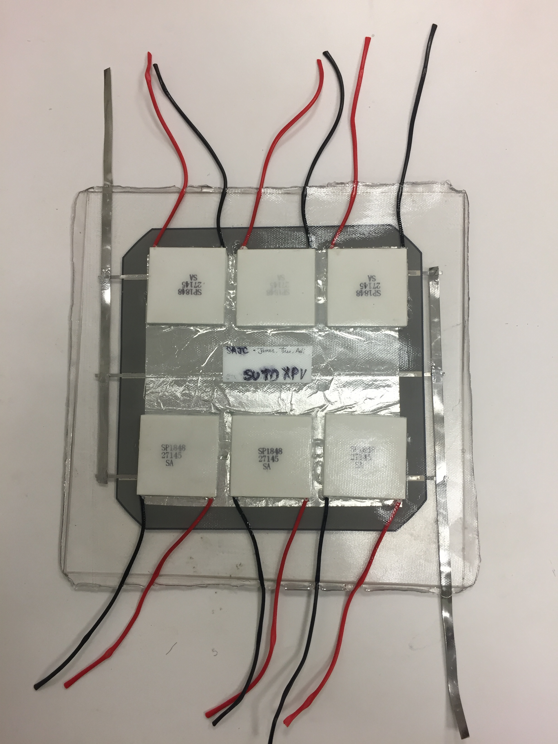
Our solution
Notes:
Introducing, the “solar thermo-photovoltaic hybrid cell”. The installation of the thermoelectric cells will cool down the temperature in the photovoltaic cell due to the transformation of heat energy into electrical energy. As a result, the efficiency of the photovoltaic cell will increases and at the same time, there is less thermal energy released to surrounding, mitigating the effect of solar panels to the UHI phenomenon.

Slide 12
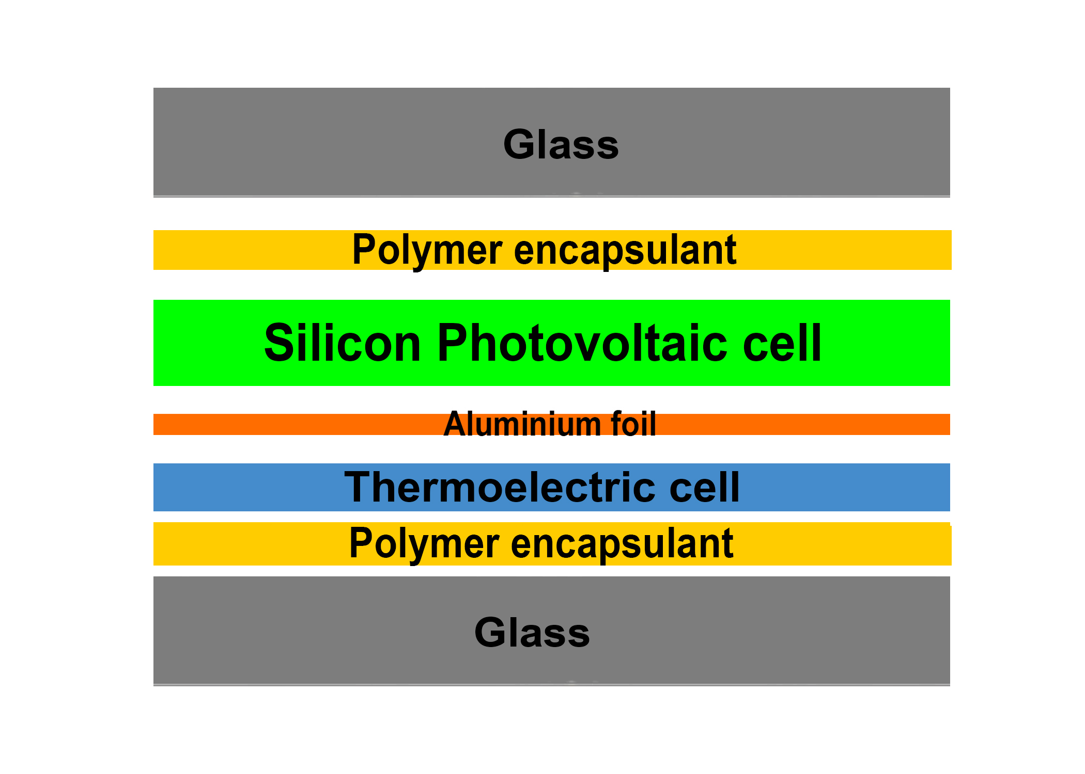
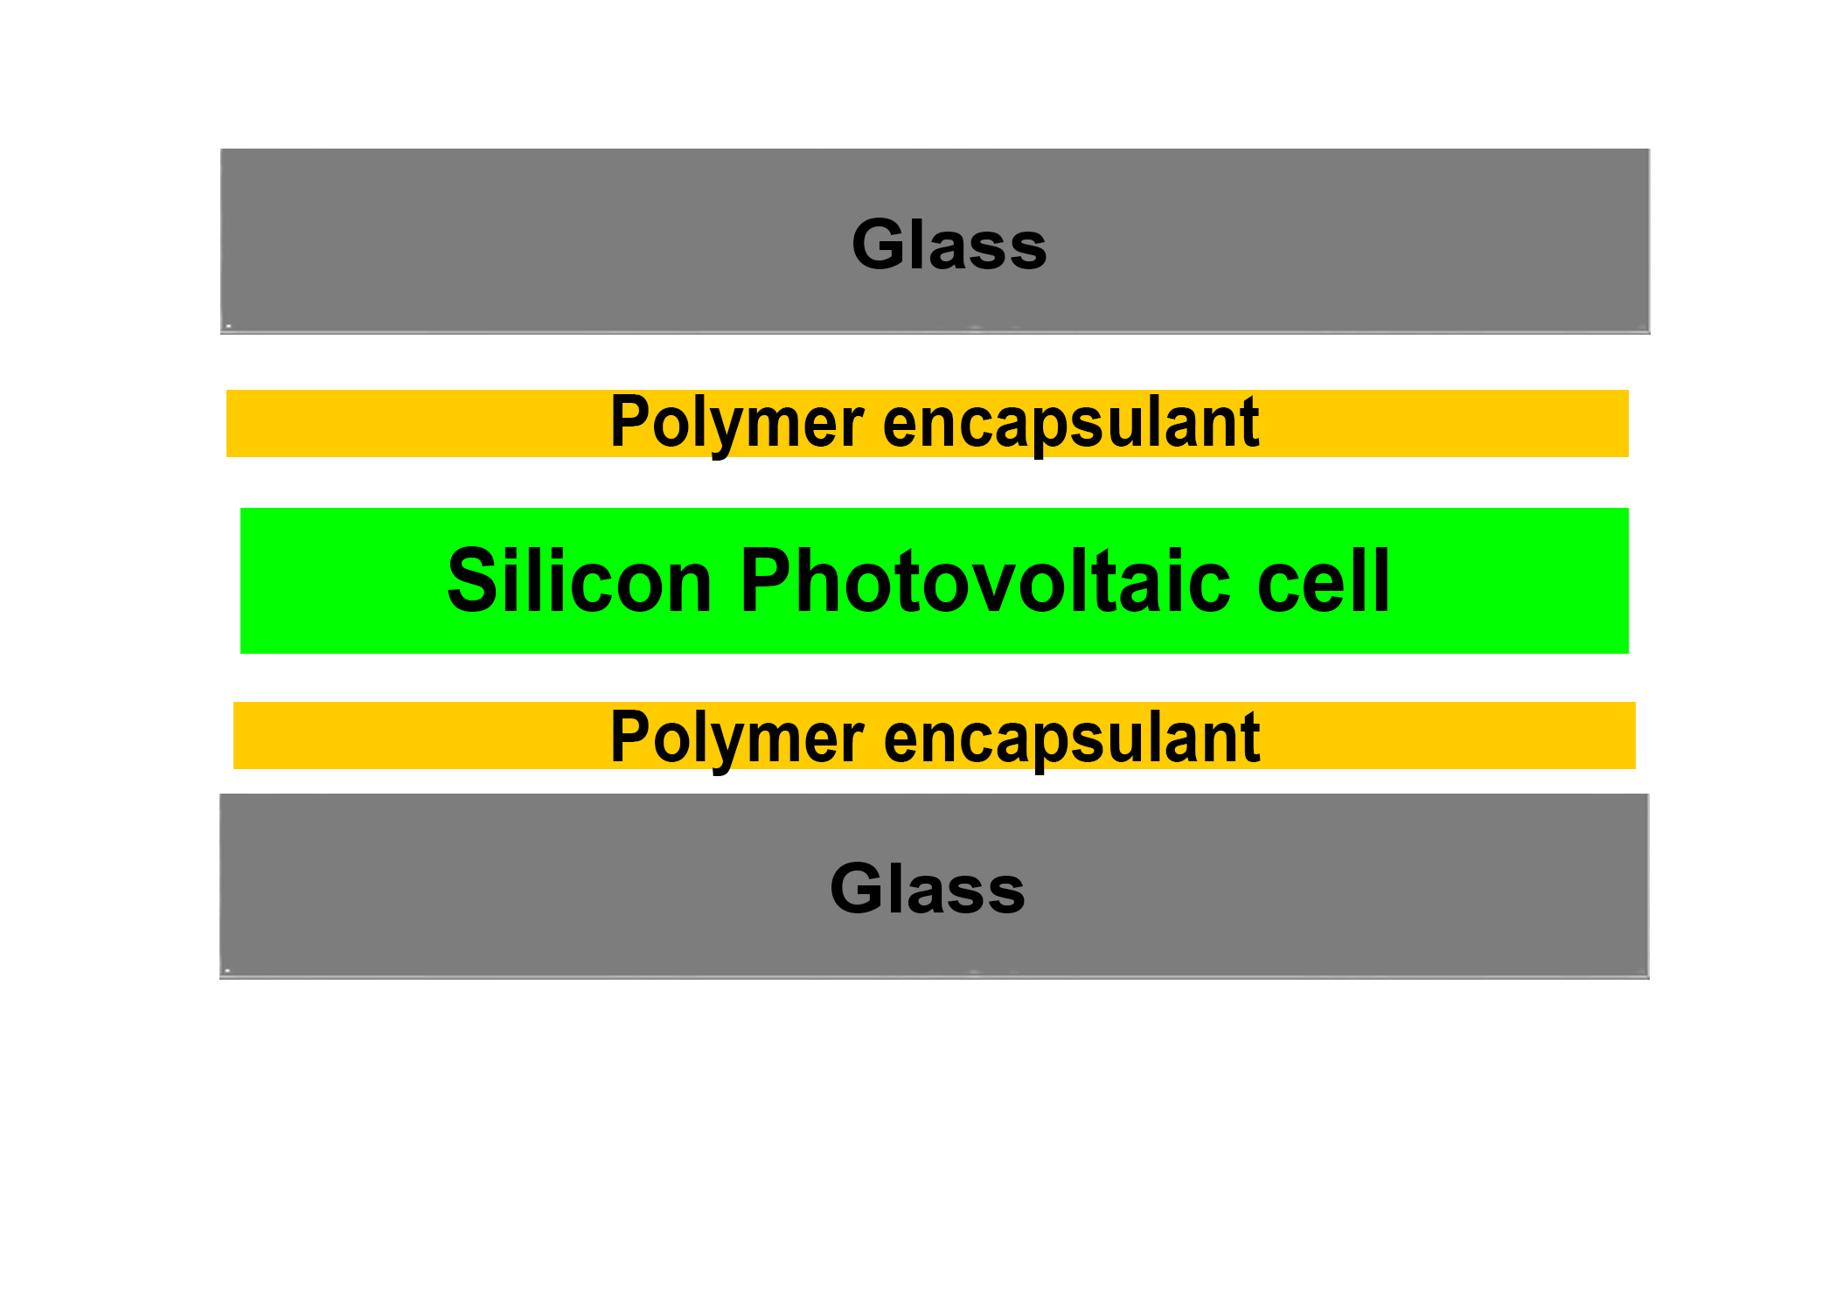
Solar thermo-photovoltaic cells
Current solar cell
Solar thermo-photovoltaic cells
Notes:
The major difference between our solar cell and the current one is the installation of the thermoelectric cell. The aluminium foil there serves to better conduct the heat in the silicon photovoltaic cell to the thermoelectric cell.

Slide 13
Future Developments
Increasing temperature difference
Increasing the efficiency of thermoelectric cells
Improvement in production
Notes:
There are several improvements that can be made, including increasing the temperature difference between the surfaces of the thermoelectric generator by applying copper fins (i.e. heatsink) to increase electrical output­­
Preventing air bubbles from forming by either closing the gap between the thermoelectric cells or by using one big thermoelectric cell as air bubbles can increase the surface area and cause more heat loss.
With the advancement in technology, thermoelectric cell with higher efficiency and energy output can be manufactured. Hence, the thermoelectric cell will produce more electricity and can further bring down the temperature of the photovoltaic cell which increase the output of the solar cell too.

Slide 14
Acknowledgement
Mr. Arief Suriadi Budiman, Ph.D., Asst. Professor, Singapore University of Technology and Design
Mr. Sasi Kumar Tippabhotla, M. Sc., Singapore University of Technology and Design
SUTD Xtreme Photovoltaics Laboratory
Mr. Lim Chong Leng, Senior Teacher, Saint Andrew’s Junior College
Ms. Peng Chai Tin, Laboratory Director, Saint Andrew’s Junior College

Slide 15
thank you

